Slide 1
Media Data Analytics
Group 4 Group Members:
Co-ordinate: Mahindra Sandhya
B.Khureshiya Kulsum
Mehak Anjum
R Subhash
Mohana Sundaram
Sneha
Manjusha

Slide 2
Introduction
In today's digital landscape, these platforms are not just communication channels; they are vast repositories of invaluable business intelligence. Analysing data from LinkedIn, Facebook, and Google allows us to understand market dynamics, consumer behaviour, and professional trends with unprecedented precision.

Slide 3
Objective
This analysis is to evaluate the performance of media campaigns across LinkedIn, Facebook, and Google.
Evaluate media performance across LinkedIn, Facebook, and Google.
Identify areas of improvement and opportunities for growth.
Provide data-driven recommendations to optimize media spend and maximize ROI.

Slide 4
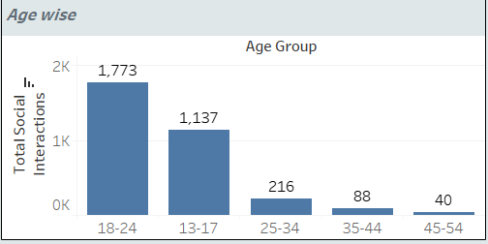
Age Wise Social Interactions
Based on the chart, here's a brief explanation of age-wise social interactions:
18-24 age group: Highest total social interactions (1,773).
13-17 age group: Second-highest total social interactions (1,137).
25-34, 35-44, 45-54 age groups: Significantly lower total social interactions (216, 88, 40 respectively).

Slide 5
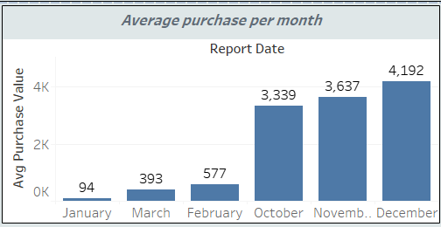
Average Purchase Per Month
Average purchase value for six months: January (94), March (393), February (577), October (3,339), November (3,637), and December (4,192).
The graph indicates a significant increase in average purchase value towards the end of the year (October to December).

Slide 6
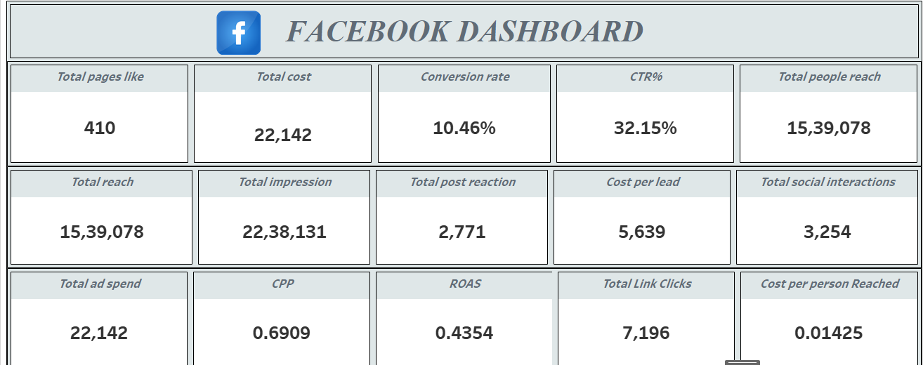
KPIS

Slide 7
KPIS
The number of people who have liked your page is 410.
The total amount spent on the ad campaign 22,142.
CTR% (Click-Through Rate): The percentage of users who clicked on the ad is 32.15%.
Total Post Reaction: The number of reactions (e.g., likes, loves) on the ad is 2771.
ROAS (Return on Ad Spend): The revenue generated per dollar spent on ads 0.4354.
Total Link Clicks: The number of clicks on the ad's link is 7196.

Slide 8
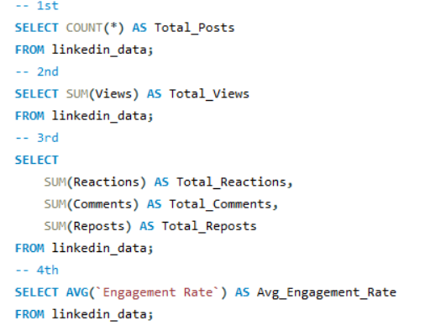
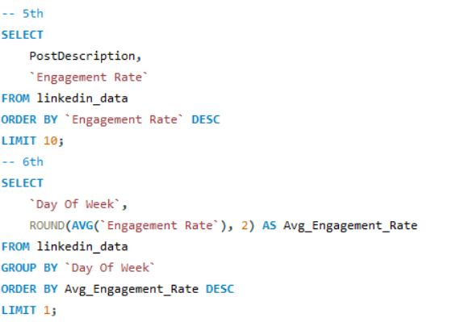
SQL Query

Slide 9
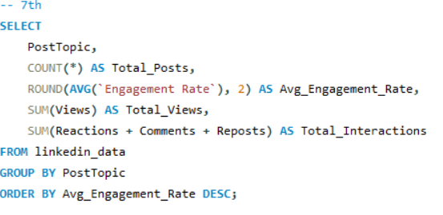

Slide 10
Thank you

